Slide 1
Communications and Media
CGPRT(W) : Ensuring Clean Seas and Coasts in Western Region ……

Slide 2
Objective
To understand the need for a communications plan and a media response plan to gather and disseminate information during an incident.
To understand some basic guidance on being interviewed
To consider the contents of a press release
CGPRT(W) : Ensuring Clean Seas and Coasts in Western Region ……

Slide 3
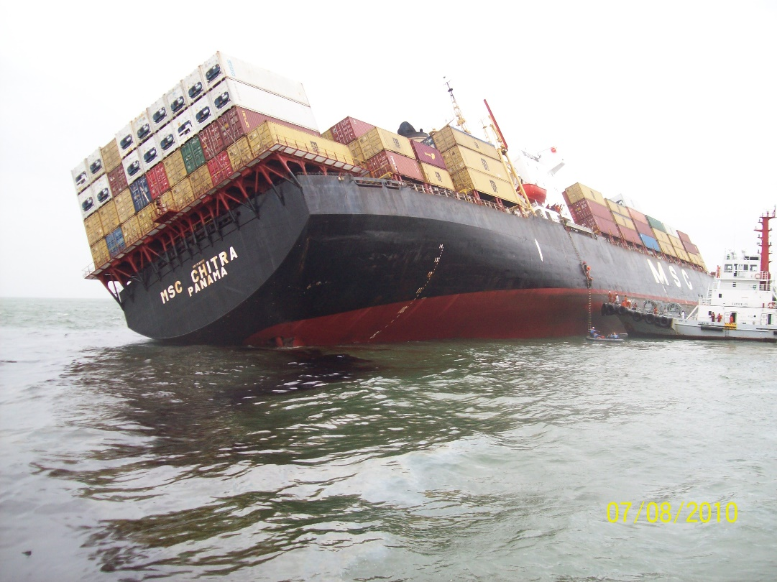
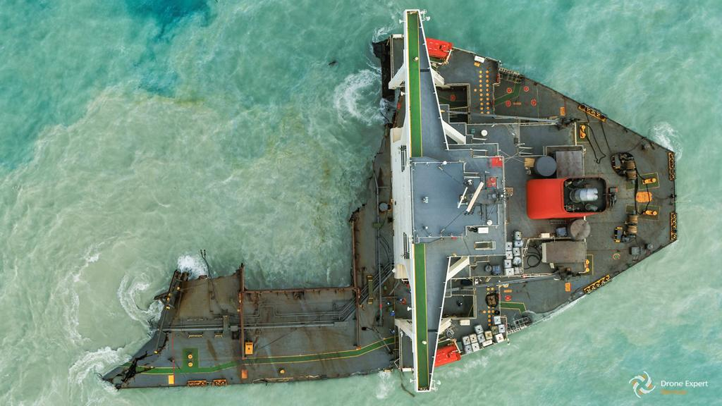
Strong visuals….
CGPRT(W) : Ensuring Clean Seas and Coasts in Western Region ……

Slide 4
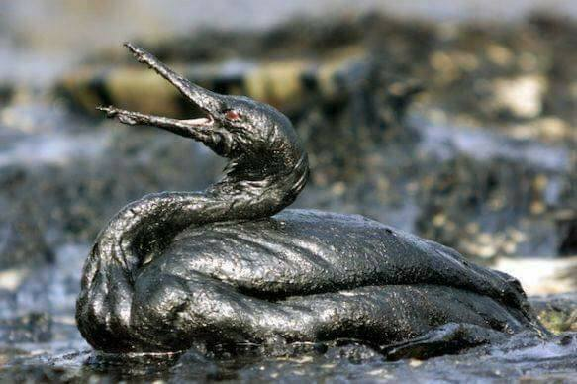
Strong visuals….
CGPRT(W) : Ensuring Clean Seas and Coasts in Western Region ……

Slide 5
Typical Challenges
Issues common to many incidents:
  Flexibility of scale
  Response organization
  Internal communication
  Management of volunteers
  Health and Safety
  Media and Public Relations
CGPRT(W) : Ensuring Clean Seas and Coasts in Western Region ……

Slide 6
Effective Response
An effective response does not necessarily depend on large amounts of specialist equipment.
However it does depend on:
  organizational infrastructure
    clearly defined and understood
  leadership
  well-managed resources
  information management
CGPRT(W) : Ensuring Clean Seas and Coasts in Western Region ……

Slide 7
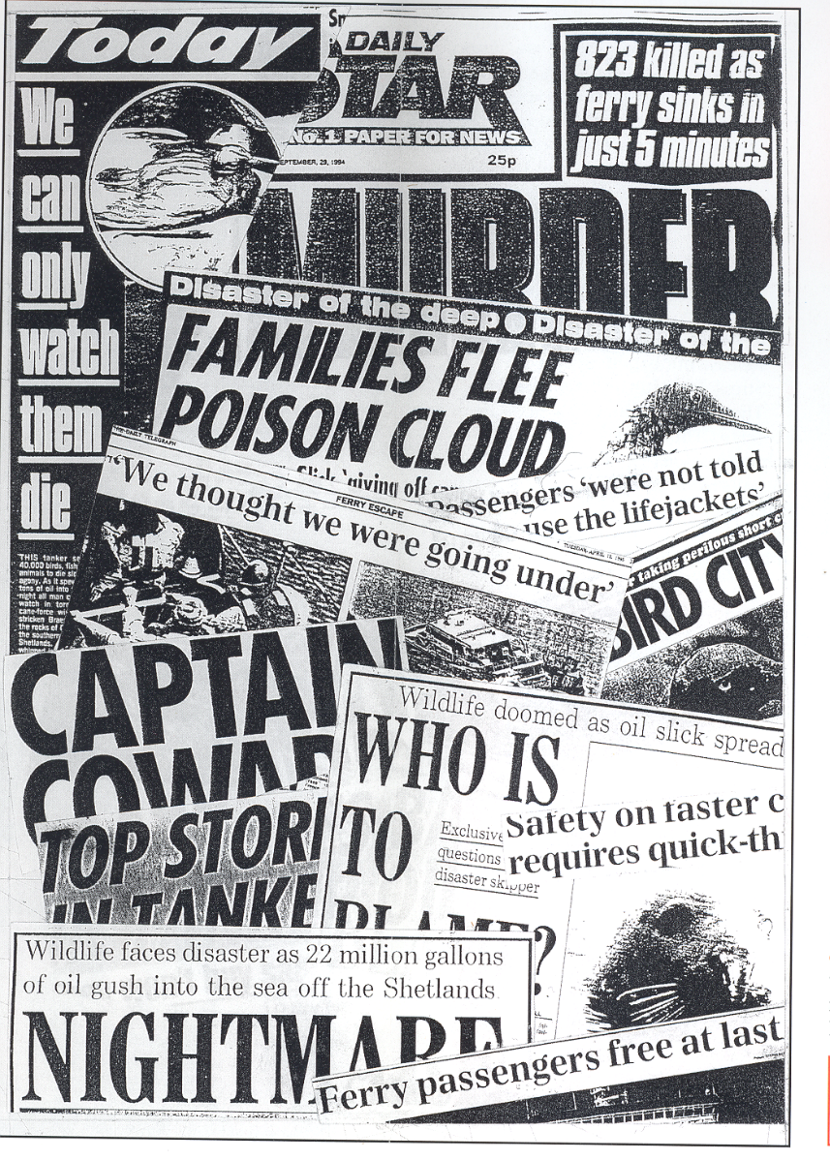
Crisis − Perception vs. Reality
Often, the real crisis is not in what actually
has happened but what people and the media believe has happened.
CGPRT(W) : Ensuring Clean Seas and Coasts in Western Region ……

Slide 8
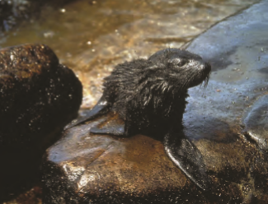
Challenges
Emergencies/
Crisis
Emotional stories
Highly visible
Public concerns
CGPRT(W) : Ensuring Clean Seas and Coasts in Western Region ……

Slide 9
Challenges
Oil spills generate bad publicity for the country, the Administration and industry
Negative impressions can be redressed with good media communications
Senior managers and administrators have a responsibility to plan and deliver that plan
CGPRT(W) : Ensuring Clean Seas and Coasts in Western Region ……

Slide 10
Information
Information can be used to:
  Warn people threatened by immediate danger
  Advise the community on how to act properly to avoid danger/hazard
  Advise on the current response operation
  Create a solid foundation for people’s faith in the response
This requires a Communications Plan
CGPRT(W) : Ensuring Clean Seas and Coasts in Western Region ……

Slide 11
Information
Information must be:
  open and accurate
  given swiftly and continuously
  simple and easily accessible
  clear and concise
CGPRT(W) : Ensuring Clean Seas and Coasts in Western Region ……

Slide 12
Media Challenges
Inequality of an emergency event
    Circumstances do not favour the authority dealing with the event
    It is a golden opportunity for the media
    Media can talk in approximate terms
    Technical/scientific information may not have an impact on public opinion
    Credibility of media can be higher than the responsibility authority
CGPRT(W) : Ensuring Clean Seas and Coasts in Western Region ……

Slide 13
Communciation Challenges
Credibility
Clear messages
Having the correct information and releasing it at the right time
Getting the attention
Seeing the crisis from the perspective of the recipient
CGPRT(W) : Ensuring Clean Seas and Coasts in Western Region ……

Slide 14
Communication Challenges
The public has a right to know
Media is the channel to the general public
Bad news travels fast
Under-siege mentality
Media plan not to be improvised
If the media is poorly managed, the impression given is that the operation is badly managed
Plan, exercise, learn lessons, update plan
CGPRT(W) : Ensuring Clean Seas and Coasts in Western Region ……

Slide 15
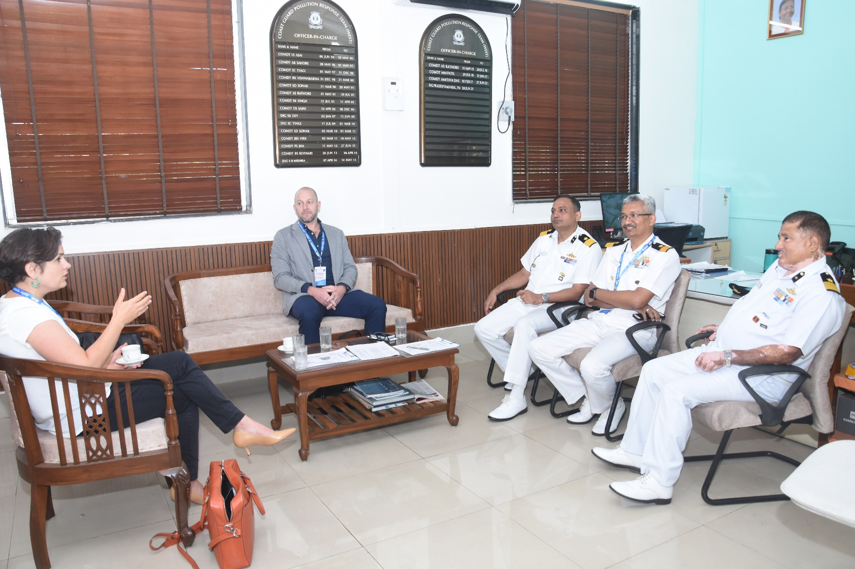
Communication Challenges
CGPRT(W) : Ensuring Clean Seas and Coasts in Western Region ……

Slide 16
Effective Response
The management of information is critical.
Information movement can be considered in two dimensions:
  Vertical (internal)
    the flow of information up and down the command structure of the incident
  Horizontal (external)
    The flow of information out to media and public
    The reaction/feedback from the media and public
CGPRT(W) : Ensuring Clean Seas and Coasts in Western Region ……

Slide 17
Two Plans
Communications plan
    Response team
    Response community
    Senior administrators/Ministers
    Regional and international contacts
Media relations plan
  Media
  Public
CGPRT(W) : Ensuring Clean Seas and Coasts in Western Region ……

Slide 18
Communication Planning
Five-step approach to communication planning.
    Audience identification
    Objective setting
    Information/message development
    Choice of appropriate communication channel(s)
    Monitoring/evaluation/review
Avoid an over-reliance on the mass media
Consider the impact of social media
CGPRT(W) : Ensuring Clean Seas and Coasts in Western Region ……

Slide 19
Social Media
Increasingly people are turning to social media during emergencies
This enables them to obtain up-to-date information as well as give feedback and share content with others
This has significantly altered the flow and availability of information during an incident
Developing a social media profile, in advance, can benefit for responders
CGPRT(W) : Ensuring Clean Seas and Coasts in Western Region ……

Slide 20
Social Media
When used effectively, social media platforms facilitate quick and direct contact with the public
An effective social media strategy will incorporate:
  Listening
  Talking
  Engaging
  Sustaining
CGPRT(W) : Ensuring Clean Seas and Coasts in Western Region ……

Slide 21
Social Media
Listening
  What are people taking about?
  What is being said about your organization or incident?
  Who is your audience?
  Where is your audience?
Talking
  Promote and introduce your organization
  Provide information that will be helpful
  Target influential individuals/audiences
CGPRT(W) : Ensuring Clean Seas and Coasts in Western Region ……

Slide 22
Social Media
Engaging
  Develop and encourage two-way conversations
  Talk with supporters and critics
  Create a growing network using content that can be shared
Sustaining
  Keep dialogue going, to be well-positioned in an emergency
  Commit necessary resources to maintain momentum
  Turn followers into advocates
CGPRT(W) : Ensuring Clean Seas and Coasts in Western Region ……

Slide 23
Social Media
Social media can generally be categorized as:
  Social networks
    Facebook, MySpace, Google+, LinkedIn
  Blogging/micro-blogging services
    Twitter, WordPress, Blogspot
  Video and picture sharing platforms
    YouTube, Flickr, Instagram
  Other crowd-based services
    Crowdmap, Tweetdeck, Addictomatic, StumbleUpon
CGPRT(W) : Ensuring Clean Seas and Coasts in Western Region ……

Slide 24
Social Media
Social media comprises of a range of communication tools with new ones emerging all the time
Be aware of which social media platform is used most by your target audience
Adopt an audience-based approach
Specialist training in social media techniques is highly recommended
CGPRT(W) : Ensuring Clean Seas and Coasts in Western Region ……

Slide 25
Social Media
Social media present challenges as well as opportunities:
  Keeping pace with developments
  The level of information to be monitored, filtered and evaluated
  The public expectation to engage in a dialogue through social media platforms
  The need to counteract rumours and misinformation, which can spread rapidly
CGPRT(W) : Ensuring Clean Seas and Coasts in Western Region ……

Slide 26
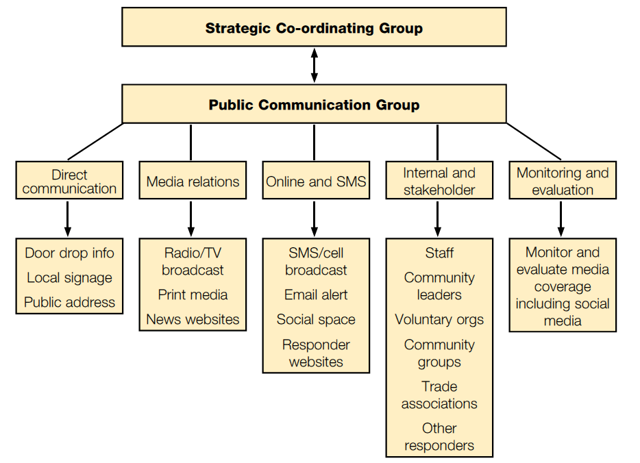
Communications Structure
Source: Scottish Government Publication – Communicating with the Public
CGPRT(W) : Ensuring Clean Seas and Coasts in Western Region ……

Slide 27
Key Elements of Communications Plan
OBJECTIVE:
  need to communicate internally and externally
STRATEGY:
  role and responsibilities; major issues; means of communication (including internet)
MESSAGE:
  company/government position; incident effects; response measures
CGPRT(W) : Ensuring Clean Seas and Coasts in Western Region ……

Slide 28
Key Elements of Communications Plan
SPOKESPERSON:
  role; limits of authority
MEDIA:
  briefings; meetings; SITREPS
RESOURCES:
  centre; equipment; personnel
CGPRT(W) : Ensuring Clean Seas and Coasts in Western Region ……

Slide 29
Priorities
Human
Life
People
Environment
Asset
Reputation
Environment
Property
CGPRT(W) : Ensuring Clean Seas and Coasts in Western Region ……

Slide 30
Focus
Expression of
regret
Assert the efforts
being done
Promise
CGPRT(W) : Ensuring Clean Seas and Coasts in Western Region ……

Slide 31
Media Relations Plan
The policy aim is:
  To provide the media with honest and accurate information at regular intervals throughout the incident
  To establish good relations with the media:
    To control the flow of information
    To avoid distortion of the facts
    To encourage the media to come to us for information
CGPRT(W) : Ensuring Clean Seas and Coasts in Western Region ……

Slide 32
Media Relations Plan
The objectives for dealing with the media:
  To establish the competent authorities as a helpful, reliable and knowledgeable source of information
  To present an efficient and environmentally caring face to the media
  To show that an efficient response strategy has been set in place
  To influence what the media write or say
CGPRT(W) : Ensuring Clean Seas and Coasts in Western Region ……

Slide 33
Media Liaison Officer
The Media liaison officer will be the “public face” of the authorities
A member of the Command function: fully informed about tactical response decisions
  Sole responsibility for handling relations with the media
  No responsibility for tactical response operations
  May be assisted by senior personnel or technical experts, as required
CGPRT(W) : Ensuring Clean Seas and Coasts in Western Region ……

Slide 34
Responsibilities for Handling the Media
Tier 1: Press officer of port or oil industry
Tier 2 or 3: Press office of Ministry which is “competent government authority”
Dependent on what system prevails in your country
Important to present a unified approach!
CGPRT(W) : Ensuring Clean Seas and Coasts in Western Region ……

Slide 35
What the Public Wants to Know!
What happened?
Why did it happen?
What are the authorities doing?
Will there be further developments?
What will be done to prevent such an accident from happening again?
? ? ? ?
CGPRT(W) : Ensuring Clean Seas and Coasts in Western Region ……

Slide 36
How an Issue Develops
Incident
  Is it newsworthy ?
  What else is happening?
Initial media interest
  Is it being badly handled?
  Is there an issue involved?
Media investigate
  Is there anything to hide?
Analysis and blame
  Specific issues requiring quick detailed answers
  Slower stage: political
CGPRT(W) : Ensuring Clean Seas and Coasts in Western Region ……

Slide 37
Media Facilities
Integrated within the IMS
Your facilities:
  Who answers the phone?
  How can you handle hundreds of calls?
  Allocate phone and fax numbers
  Managing press conferences
  Access to site or key experts
  Conducted media tours
  “a Media contingency plan”
CGPRT(W) : Ensuring Clean Seas and Coasts in Western Region ……

Slide 38
Press Facilities
Near to but not within the IMS − generally a neutral area
Provide:
  Sufficient space
  Working area
  Power
  Parking
  Domestic facilities
  Conference facilities
    Stage, podium, lighting, sound system, press releases
CGPRT(W) : Ensuring Clean Seas and Coasts in Western Region ……

Slide 39
The Press Release
The press release should:
  Admit involvement
  Give basic facts
  Express regret
  Say what is being done to improve the situation
  Give a press contact
CGPRT(W) : Ensuring Clean Seas and Coasts in Western Region ……

Slide 40
The Press Release
The press release must not:
  Speculate on causes
  Blame parties
  Admit liability
  Use jargon
  Be arrogant
CGPRT(W) : Ensuring Clean Seas and Coasts in Western Region ……

Slide 41
Interview Guidelines
Write an advance list of the points you want to make
Keep answers short and to the point
Avoid technical jargon or acronyms
Memorize the most important points
Treat every word as “on the record”
Be patient, calm and simple: journalists are not oil pollution experts!
CGPRT(W) : Ensuring Clean Seas and Coasts in Western Region ……

Slide 42
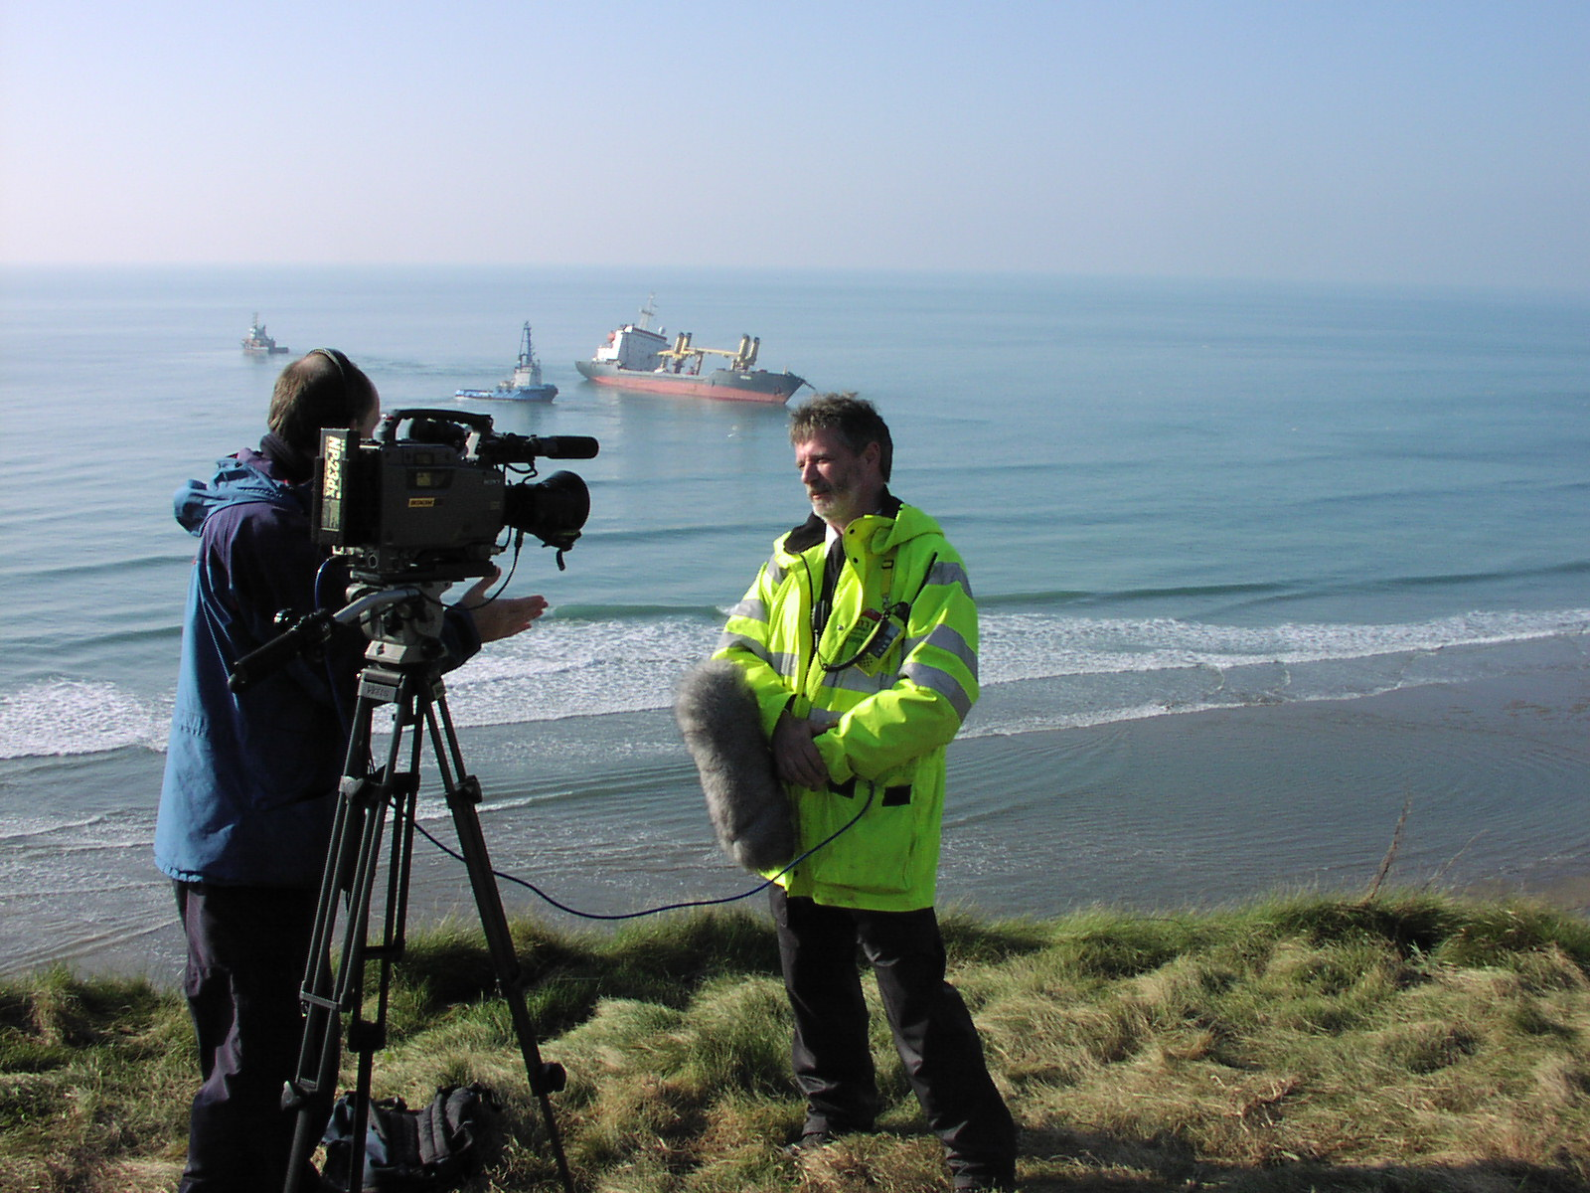
CGPRT(W) : Ensuring Clean Seas and Coasts in Western Region ……

Slide 43
Interview “Do’s”
Stick to your area of expertise
Prepare your statement
Express regret, care and concern for any victims and their families
Get bad news out first, stick to the facts
Answer the questions, but return to your message
Ask the question to be repeated if you don’t understand it
Put the story in context, define the problem
CGPRT(W) : Ensuring Clean Seas and Coasts in Western Region ……

Slide 44
Interview “Do’s”
Keep track of what was said during the interview
Stay calm, cool and clear headed
Give full story, be honest, accessible, understanding
Communicate information at the earliest time
Ensure you have a recording of your statement and interview
If you undertake to provide further information or elaboration ensure that you provide it!
CGPRT(W) : Ensuring Clean Seas and Coasts in Western Region ……

Slide 45
Interview “Don’ts”
Never guess: stick to the facts
Do not bluff: keep cool before answering difficult questions
Do not lose your temper even if provoked
Never answer a question until you understand it properly
CGPRT(W) : Ensuring Clean Seas and Coasts in Western Region ……

Slide 46
Prepare in Advance
Many facilities can be prepared in advance and lie dormant until activated:
  Incident website
  Photographs
  Fact sheets
  Contact details
CGPRT(W) : Ensuring Clean Seas and Coasts in Western Region ……

Slide 47
Key Messages
Responsibility to communicate:
  Internally: ↑senior managers and ↓ responders
  Externally: media; general public
Importance of regular briefing:
  Sharing of information
  Situation reviews → action plans
Importance of media role
Media is the channel to the general public
CGPRT(W) : Ensuring Clean Seas and Coasts in Western Region ……

Slide 48
Summary
In this lesson we have considered the need for a communications plan to gather and disseminate information during an incident.
We have also considered how best to address communications planning.
CGPRT(W) : Ensuring Clean Seas and Coasts in Western Region ……

Slide 49
Any questions?
CGPRT(W) : Ensuring Clean Seas and Coasts in Western Region ……

